Slide 1
NMI IRQ
FIRQ RST
JMP
EA → PC
Memory
Bus
BRA
M → Temp
PC + Temp → PC
Bus
Address
PC
Control
Unit
Microcode
BNE
M → Temp
IF Z = 0
PC + Temp → PC
Data
Fetch
IDX
Decoder
Registers
Data
Write
Operand 0
Operand 1
ALU

Slide 2
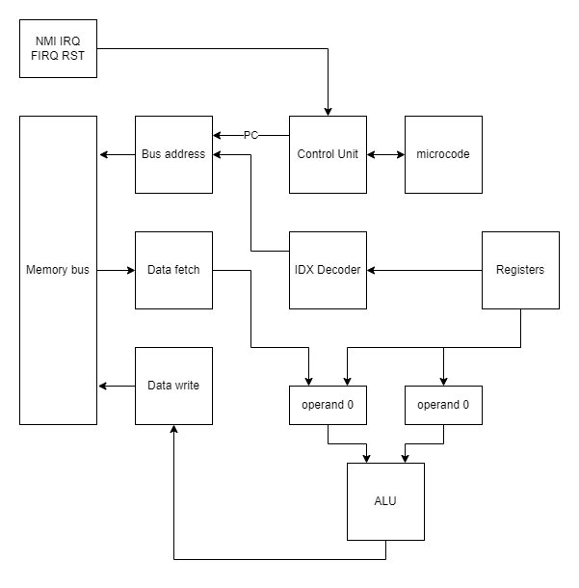
NMI IRQ
FIRQ RST
ADD 8bits
R + M → R
R → op1, M → op0
op0 + op1 → AluOut
AluOut → R
ADDD 16bits
R + M:M + 1 → R
R → op0 ; R1 → op2
op0 + op1 → AluOut
AluOut → R
Memory
Bus
Bus
Address
Control
Unit
Microcode
Data
Fetch
IDX
Decoder
Registers
Data
Write
Operand 0
Operand 1
ALU

Slide 3
NMI IRQ
FIRQ RST
CMP 8bits
R - M → Temp
R → Op1 ; M →Op0
Op1 – Op0 → AluOut
AluOut → Temp
CMP 16bits
R - M:M + 1 → Temp
R - M → Temp
R → Op1 ; M →Op0
Op1 – Op0 → AluOut
AluOut → Temp
Memory
Bus
Bus
Address
Control
Unit
Microcode
Data
Fetch
IDX
Decoder
Registers
Data
Write
Operand 0
Operand 1
ALU
Temp

Slide 4
NMI IRQ
FIRQ RST
ABX
ACCB → Op0 ; RX → Op1
Op0 + Op1 → AluOut
AluOut → RX
Memory
Bus
Bus
Address
Control
Unit
Microcode
Data
Fetch
IDX
Decoder
Registers
Data
Write
Operand 0
Operand 1
ALU

Slide 5
NMI IRQ
FIRQ RST
AND
R → Op1; M → Op0
Op0 & op1 → AluOut
AluOut → R
OR
R → Op1; M → Op0
Op0 || op1 → AluOut
AluOut → R
Memory
Bus
Bus
Address
Control
Unit
Microcode
Data
Fetch
IDX
Decoder
Registers
INC
M → Op0
Op0 + 1 → AluOut
AluOut → M
DEC
M → Op0
Op0 - 1 → AluOut
AluOut → M
Data
Write
Operand 0
Operand 1
ALU

Slide 6
NMI IRQ
FIRQ RST
COM Memory
M → Op0
0 + Op0 → AluOut
AluOut →
COM ACC(A o B)
ACC → Op1
0 + Op1 → AluOut
AluOut → ACC
Memory
Bus
Bus
Address
Control
Unit
Microcode
Data
Fetch
IDX
Decoder
Registers
Data
Write
Operand 0
Operand 1
ALU

Slide 7
NMI IRQ
FIRQ RST
LD 8bits
M → Op0
Op0 → R
ST 8Bits
R → Op0
Op0 → M
Memory
Bus
Bus
Address
Control
Unit
Microcode
Data
Fetch
IDX
Decoder
Registers
LD 16bits
M → Op0;
Op0 → R
ST 16Bits
R → Op0
Op0 → M
Data
Write
Operand 0
Operand 1
ALU

Slide 8
NMI IRQ
FIRQ RST
EXG
R1 → Op0; R2 → Op1
Op0 ↔ Op1 → AluOut
AluOut → R0, R1
TFR
R1 → Op0; R2 → Op1
Op0 → Op1
Op1 → R2
Memory
Bus
Bus
Address
Control
Unit
Microcode
Data
Fetch
IDX
Decoder
Registers
Data
Write
Operand 0
Operand 1
ALU

Slide 9
NMI IRQ
FIRQ RST
TST
M → Op0
Op0 - 0→ AluOut
AluOut → Temp
BIT
ACC → Op1; M→ Op0
Op1 & Op0 → AluOut
AluOut → Temp
Memory
Bus
Bus
Address
Control
Unit
Microcode
Data
Fetch
IDX
Decoder
Registers
Data
Write
Operand 0
Operand 1
ALU
Temp

Slide 10
NMI IRQ
FIRQ RST
EOR
M → Op0; ACC → Op1
Op0 ^ Op1→ AluOut
AluOut → ACC
^ = xor
Memory
Bus
Bus
Address
Control
Unit
Microcode
Data
Fetch
IDX
Decoder
Registers
Data
Write
Operand 0
Operand 1
ALU

Slide 11
NMI IRQ
FIRQ RST
SEX
ACCB
IF Bit 7 = 1
ACCA ← FF16
ELSE
ACCA ← 0016
DAA
ACCA → Op0;
Op0 +
Memory
Bus
Bus
Address
Control
Unit
Microcode
Data
Fetch
IDX
Decoder
Registers
Data
Write
Operand 0
Operand 1
ALU

Slide 12
LSR
R → Op0
Op0 → AluOut
AluOut → 0
AluOut → R
LSL
R → Op0
Op0→ AluOut
AluOut ← 0
AluOut → R
NMI IRQ
FIRQ RST
Memory
Bus
Bus
Address
Control
Unit
Microcode
ASR
R → Op0
Op0 → Op0 → AluOut
AluOut → R
ASL
R → Op0
Op0 ← 0 → AluOut
AluOut → R
Data
Fetch
IDX
Decoder
Registers
Data
Write
Operand 0
Operand 1
ROR
R → Op0
Op0 → 0 → AluOut
AluOut → R
ROL
R → Op0
Op0 → 0 → AluOut
AluOut → R
ALU

Slide 13
NMI IRQ
FIRQ RST
Memory
Bus
Bus
Address
Control
Unit
Microcode
Data
Fetch
IDX
Decoder
Registers
Data
Write
Operand 0
Operand 1
ALU

Slide 14
NMI IRQ
FIRQ RST
Memory
Bus
Bus
Address
Control
Unit
Microcode
Data
Fetch
IDX
Decoder
Registers
Data
Write
Operand 0
Operand 0
ALU

Slide 15
LOW
PRIORITY
HIGH
Continue
Continue
IRQ
FIRQ
NMI
RESET
Start / Stop
Start / Stop
Start / Stop
Start
PROG.
CPU → IRQ → Stop → | FIRQ | →Continue → Finish
CPU → FIRQ → Stop → | NMI |→ Continue → Finish
CPU → NMI → Finish
CPU → RESET

Slide 16
PROGRAMA
IRQ
PROGRAMA
FIRQ
PSHS ALL
PSHS PC
PSHS CC
Addr
Addr
Addr+1
Addr + 1
PROGRAMA
NMI
PSHS ALL
Addr
Addr+1

Slide 17
PROGRAMA
IRQ
FIRQ
PROGRAMA
IRQ
NMI
Addr1
Addr
Addr1
Addr
Addr1+1
Addr1+1
Addr+1
Addr+1
PROGRAMA
FIRQ
NMI
Addr
Addr+1
Addr1
Addr1+1

Slide 18
PROGRAMA
IRQ
FIRQ
NMI
Addr
Addr1
Addr2
Addr+1
Addr1+1
Addr2+1
Addr2+1 / 11
Addr1+1 / 10
Addr1 / 10
Addr1 / 10
Stack
Addr+1 / 00
Addr+1 / 00
Addr+1 / 00
Addr+1 / 00
Addr+1 / 00
PC
Addr
irq
firq
nmi
firq
irq
Addr+1
CC
00
10
11
11
11
10
00

Slide 19
FIRQ
NMI
PROGRAMA
Addr1
Addr1+1
Addr
Addr+1
IRQ

Slide 20
IRQ
NMI
PROGRAMA
Addr1
Addr1+1
Addr
Addr+1
FIRQ
Addr1
Addr1+1

Slide 21
FIRQ
NMI
PROGRAMA
Addr1
Addr1+1
Addr
Addr+1
IRQ
Addr
Addr+1

